Slide 1
Food Delivery Website

Slide 2
Problem Statement
Modern food delivery apps face several challenges that reduce user satisfaction and operational efficiency.
Users often experience:
Difficulty choosing food due to overwhelming menu options.
Lack of personalization, resulting in irrelevant or repetitive suggestions.
Unreliable real-time order updates and poor delivery tracking.
Delayed or failed payments due to complex payment flows.
Restaurant-side inefficiencies, such as slow order acceptance and poor visibility of ongoing orders.

Slide 3
Product/ Solution - Innovation
AI-powered food recommendations for personalized choices
Real-time tracking with live delivery updates
Seamless digital payments with instant confirmation
Smart restaurant dashboard for faster order management
Clean, user-friendly interface for quick and easy ordering

Slide 4
How It Solves the Problems
AI Suggestions reduce confusion and help users quickly pick the right meal
Real-time tracking removes uncertainty and improves delivery transparency
Instant digital payments prevent delays and failed transactions
Efficient restaurant dashboard speeds up order preparation and reduces errors
Smooth UI flow ensures faster ordering with fewer steps

Slide 5
Type of Innovation
Product Innovation:
Introduces AI-powered food discovery and real-time tracking as a smarter
alternative to traditional food delivery apps.
Process Innovation:
Streamlines ordering, payment, and restaurant operations with automated
workflows and live updates.
Experience Innovation:
Enhances user satisfaction through personalization, intuitive UI, and
transparent delivery visibility.

Slide 6
Product/ Solution - Readiness Level
Product / Solution – Readiness Level
Prototype Completed:
Core modules like user login, restaurant listing, ordering, payments, and tracking are functional.
AI Recommendation MVP Ready:
Basic rule-based recommendation engine implemented; can be upgraded to ML.
End-to-End Workflow Tested:
Users can browse → order → pay → track → receive delivery successfully.
Deployment-Ready Architecture:
Frontend, backend, and database are integrated and can run locally or on a cloud server.
Suitable for Pilot Launch:
Platform is stable enough for real-user testing with limited restaurants.

Slide 7
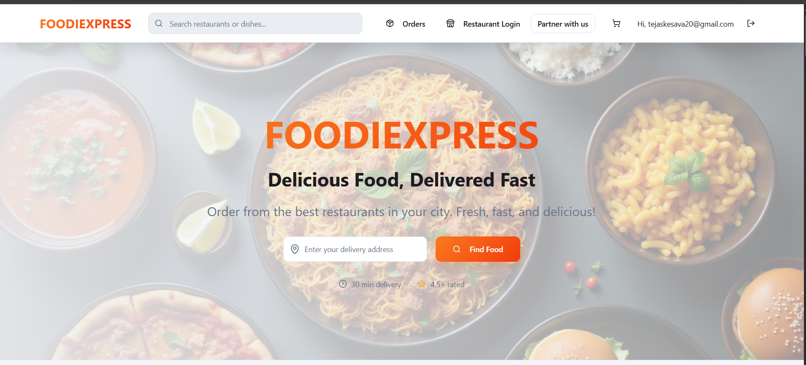
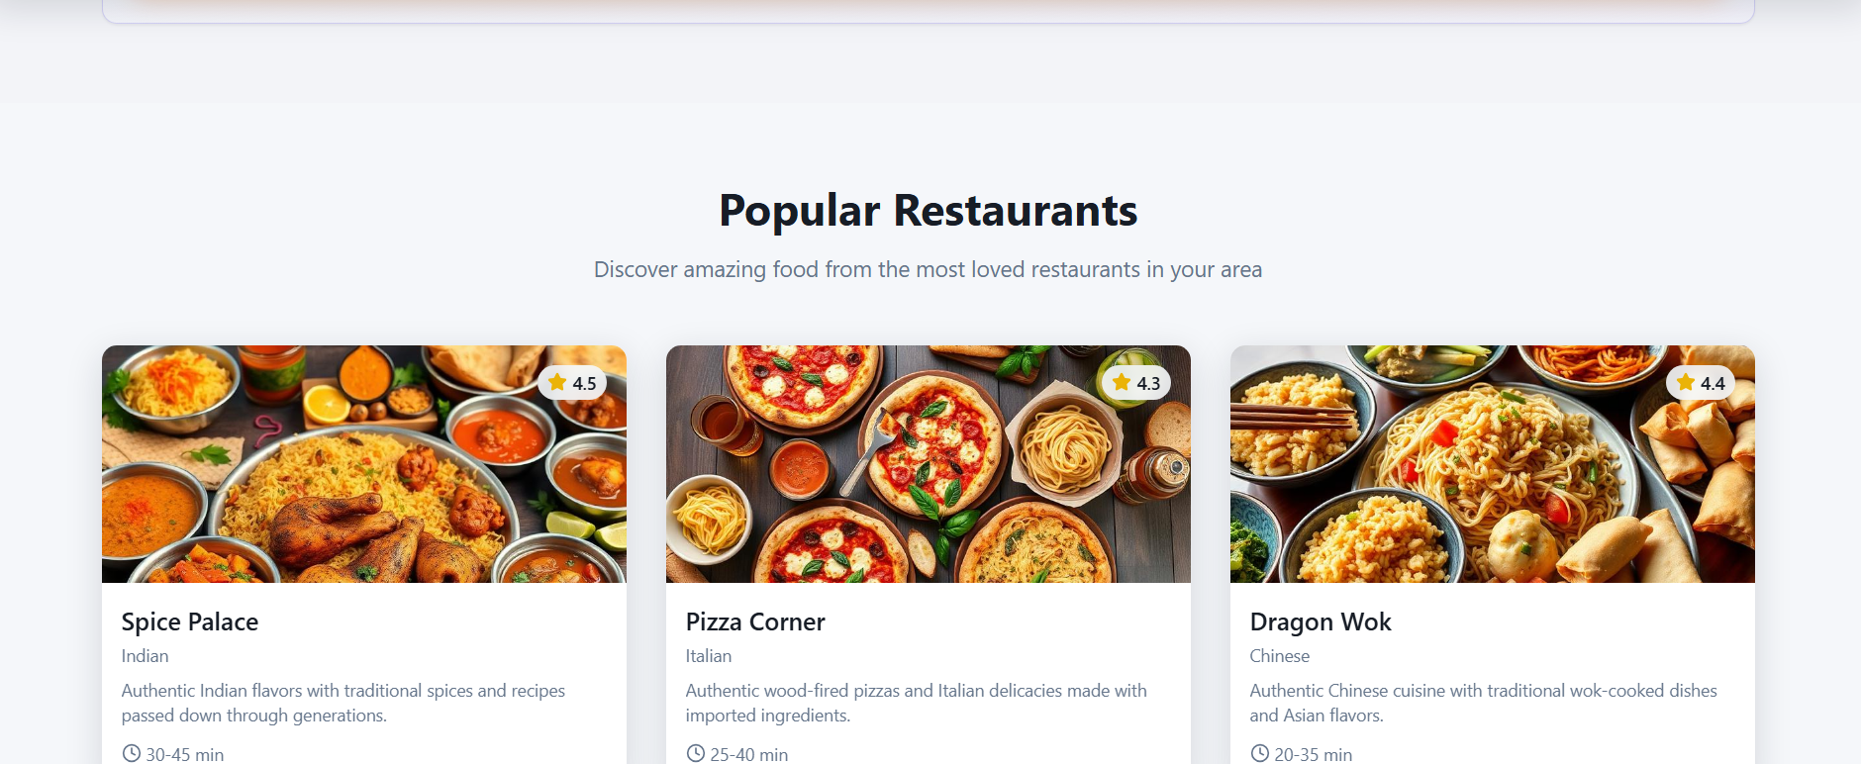
Post the images of product

Slide 8
Team Size, Background, Strength /Capability and Resources
Member-1
Name: TEJAS K
Designation: Backend Developer
Individual Contribution to Product: Designed and implemented the backend using Flask/Node.js; developed RESTful APIs for chatbot, user management, and data storage; integrated database and ensured secure data handling.
Member-2
Name: S VINEET
Designation: Frontend Developer
Individual Contribution to Product: Built the responsive web interface using React and Tailwind CSS; developed chatbot UI, HR dashboard, and forms for onboarding and exit interviews; ensured smooth user experience.
Member-3
Name: Y RAKESH
Designation: Tester
Individual Contribution to Product: focused on maintaining high product quality, validating all user journeys, and ensuring the SmartBite platform delivers a smooth, error-free experience to customers and restaurant partners.
Member-4
Name: T.John White
Designation: Frontend and Backend Connector
Individual Contribution to Product: ensured that the SmartBite platform functioned seamlessly as a unified system, bridging the gap between the frontend user interface and backend data operations for a fast and reliable food delivery experience.

Slide 9
Market Landscape - Market Potential, Competitors
📈 Market Potential
Online food delivery market in India is growing rapidly, projected to reach $20+ billion in the next few years.
Increased smartphone usage, UPI payments, and demand for convenience are driving adoption.
Rising interest in personalized, AI-driven experiences gives FOODIEXPRESS a strong advantage.
🏆 Key Competitors
Swiggy – large network, strong delivery ecosystem
Zomato – extensive restaurant partnerships, offers & promotions
Uber Eats (historically) – tech-driven experience
Local food delivery apps in Tier-2/3 cities
🎯 Competitive Edge of FOODIEXPRESS
AI-powered personalization (unique differentiator)
Transparent real-time tracking
Faster, smoother ordering experience
Designed for small/local restaurants to onboard easily

Slide 10
Market Landscape - Market Potential, Competitors
Major Competitors in the Food Delivery Market
Swiggy – Strong logistics network & wide restaurant coverage
Zomato – Large customer base, heavy discounts, strong brand presence
How FOODIEXPRESS Stands Out
AI-driven personalized food recommendations
Lightweight, faster ordering workflow
More transparent real-time tracking
Better onboarding for small/local restaurants

Slide 11
Business Model & Strategy
Business Model & Strategy
💰 Revenue Model
Commission per order from partnered restaurants
Delivery fee charged to customers
Subscription model for restaurants (premium analytics, priority listing)
Advertisement slots for restaurants to boost visibility
📌 Strategy
Target college students, office-goers, and urban users
Focus on Tier-2 & Tier-3 cities with less competition
Use AI personalization to improve repeat orders
Onboard local restaurants quickly with simple dashboards
Build user trust with accurate real-time tracking and fast checkout

Slide 12
Business Model
1. Commission-Based Revenue
A small commission is charged to restaurants for every successful order processed.
2. Delivery Fee
Customers pay a nominal delivery charge based on distance and demand.
3. Restaurant Subscription Plans
Premium features like priority listing, analytics, and promotional tools available through monthly subscriptions.
4. In-App Promotions & Advertisements
Restaurants can pay for highlighted placements, banner ads, or featured listings.
5. Data-Driven Insights (Future Model)
Aggregate insights (non-personalized) offered to restaurants to optimize menus and pricing.

Slide 13
Revenue Sharing:
1. Commission per Order
FOODIEXPRESS earns a fixed percentage commission from each order placed through the platform.
Restaurants keep the remaining amount
2. Delivery Fee Split
Delivery charges paid by customers are shared between:
  FOODIEXPRESS (platform fee)
  Delivery partner (if applicable)
3. Subscription-Based Revenue (Premium Restaurants)
Restaurants opting for premium features contribute a monthly subscription fee.
4. Promotional Revenue
Restaurants can pay to be featured, boosting visibility and generating extra platform revenue.

Slide 14
Product Milestones
1. Concept & Requirement Definition
Identified user needs, market gaps & core features
Finalized architecture and technology stack
2. Prototype Development
Built initial UI screens
Implemented core features: food browsing, cart, ordering
3. AI Recommendation Engine (MVP)
Added basic rule-based food suggestions
Integrated into homepage & restaurant pages
4. Real-Time Payment & Tracking Integration
Connected to payment gateway
Implemented live order status & map tracking

Slide 15
Product Milestones
5. Testing & Refinement
Functional, performance & UAT testing completed
Fixed issues and improved UX
6. Deployment Readiness
Backend, frontend & database fully integrated
Project ready for pilot launch

Slide 16
Total Budget, Required Support and Regulation
💰 Total Budget
Estimated initial development & launch cost:
Development & Design: ₹40,000 – ₹60,000
Hosting & Deployment: ₹5,000 – ₹10,000 per year
Testing & Tools: ₹5,000
Marketing & Promotion: ₹10,000 – ₹20,000
Contingency: ₹5,000
➡ Total Estimated Budget: ₹60,000 – ₹95,000

Slide 17
🤝 Required Support
Technical Support:
  Cloud hosting support
  Payment gateway onboarding assistance
Business Support:
  Restaurant partnerships
  Local vendors onboarding
Academic/Institutional Support:
  Access to labs, servers, mentors
📜 Regulations & Compliance
FSSAI compliance for partnered restaurants
Data Privacy & Protection: No storage of sensitive payment details
UPI/Payment Gateway Compliance: Must follow RBI guidelines
Content Policies: Only verified restaurants and safe menu listings

